Slide 1
FPGA’s: a new attack surface for embedded adversaries.
John Dunlap

Slide 2
About Me
@JohnDunlap2
Security Researcher
Reverse Engineer
Avid collector of bad software
Work for GDSSecurity doing code review / RE / Research

Slide 3
What’s this talk about?
FPGA’s – What are the security concerns?
Also it’s about moving fast, because this is a deep deep topic in a relatively short talk.

Slide 4
Who is the intended audience?
Security Engineers / Static Analysis People who want to get into FPGAs
Not deep FPGA SME’s, you may not get as much out of this due to time constraints.

Slide 5
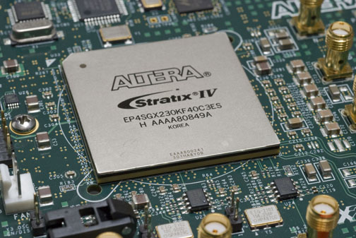
What are FPGAs?

Slide 6
Field Programmable
You can think of it as a CPU you can reprogram yourself
All of the behaviors of a CPU are yours to define – registers, memory etc..

Slide 7
Gate Array
Ostensibly an array of Gates.
Not actually, but you are meant to think that way

Slide 8
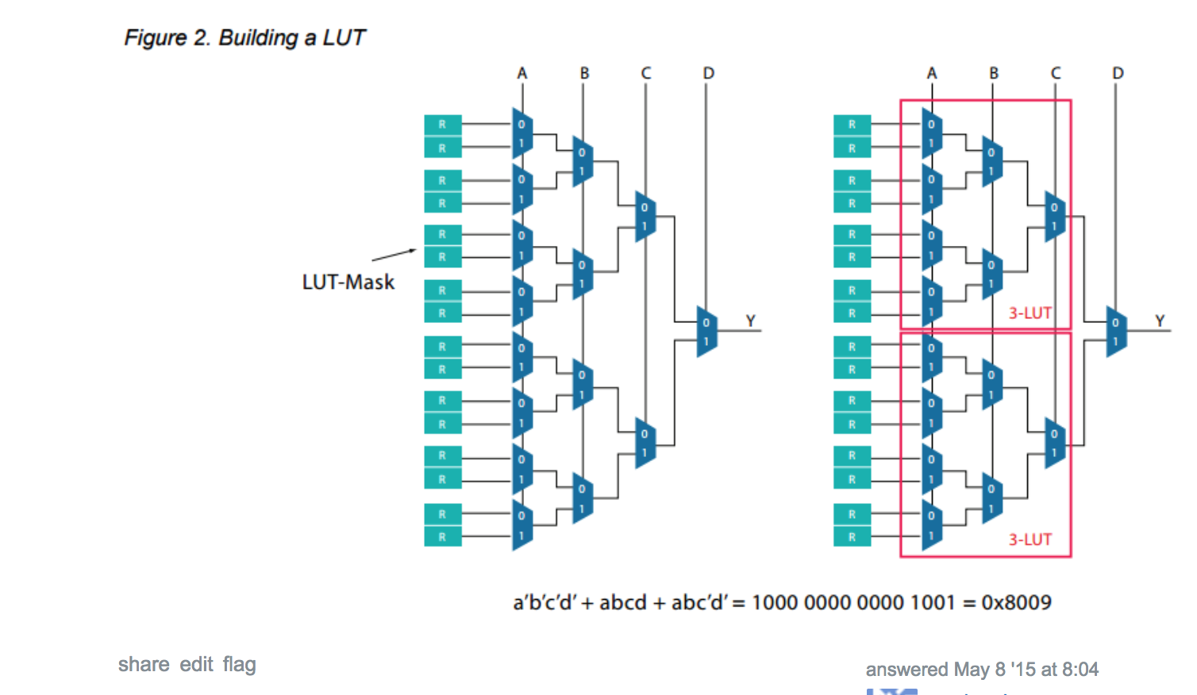
In Reality: LUTs (https://electronics.stackexchange.com/questions/169532/what-is-an-lut-in-fpga)

Slide 9
Most of the time. There are likely deafening sounds of “well actually” in the audience at the moment.

Slide 10
In reality there are many types of hybrid devices that behave differently.

Slide 11
FPGA Flavors (This Relevant to Security!)
FPGA’s come in a dizzying variety of types that all behave differently
Different power consumption levels
Different sizes
Different storage methods
Hybrid FPGA/CPLD setups

Slide 12
FPGA Storage Types
SRAM
Antifuse
PROM
EEPROM
EPROM
Flash

Slide 13
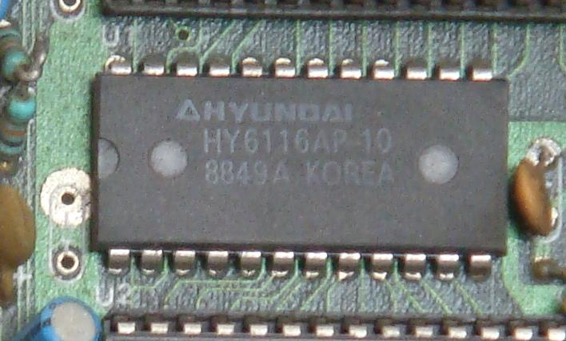
SRAM

Slide 14
Static Ram
Boots from a CMOS
Can be easily reconfigured on the fly

Slide 15
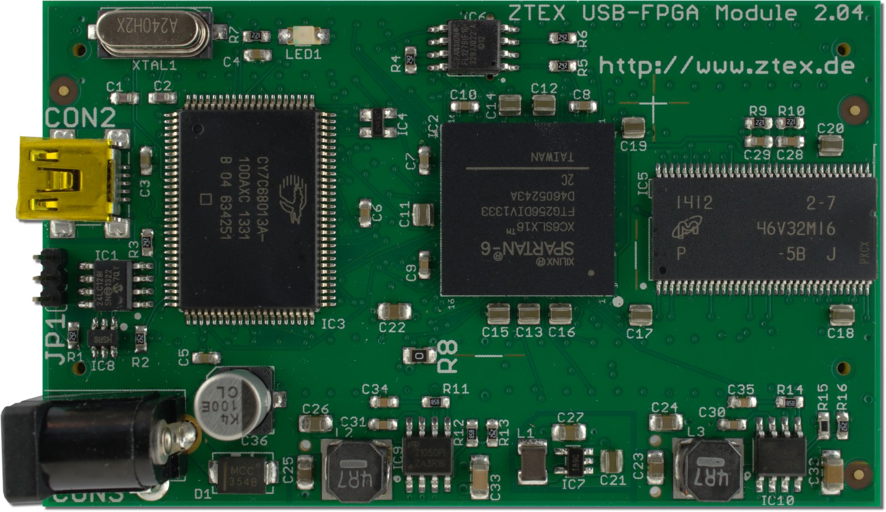
EEPROM

Slide 16
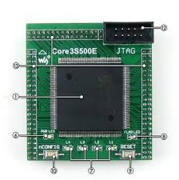
Flash

Slide 17
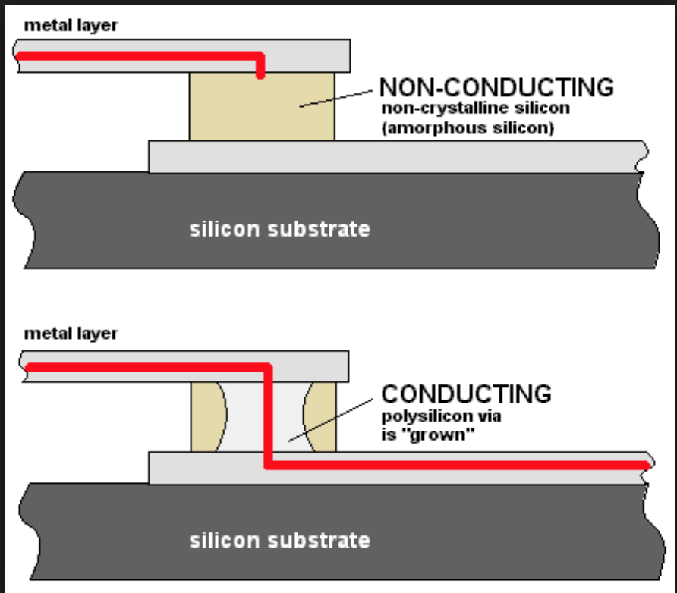
Antifuse FPGA

Slide 18
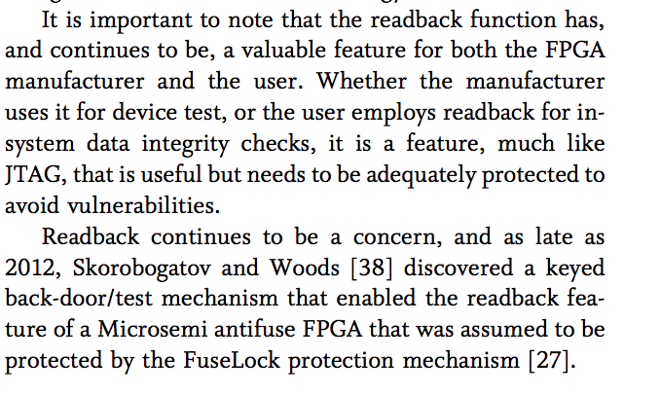
But even some antifuse FPGA’s have readback
Trimberger (https://ieeexplore.ieee.org/stamp/stamp.jsp?arnumber=6849432)

Slide 19
What are people using FPGA’s for?
Everything

Slide 20
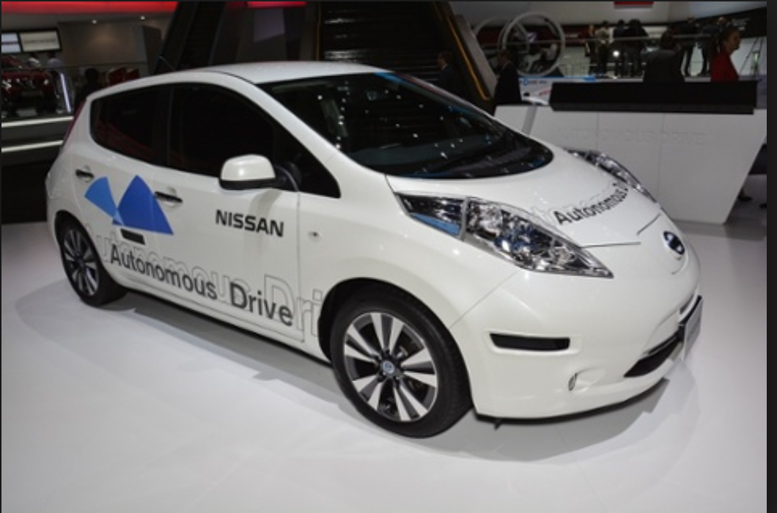
Vehicles without Drivers

Slide 21
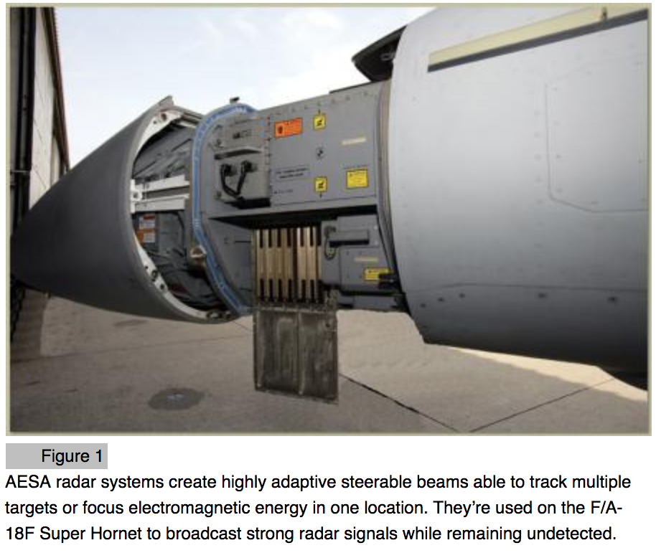
Military Stuff (http://archive.cotsjournalonline.com/articles/view/102372)

Slide 22
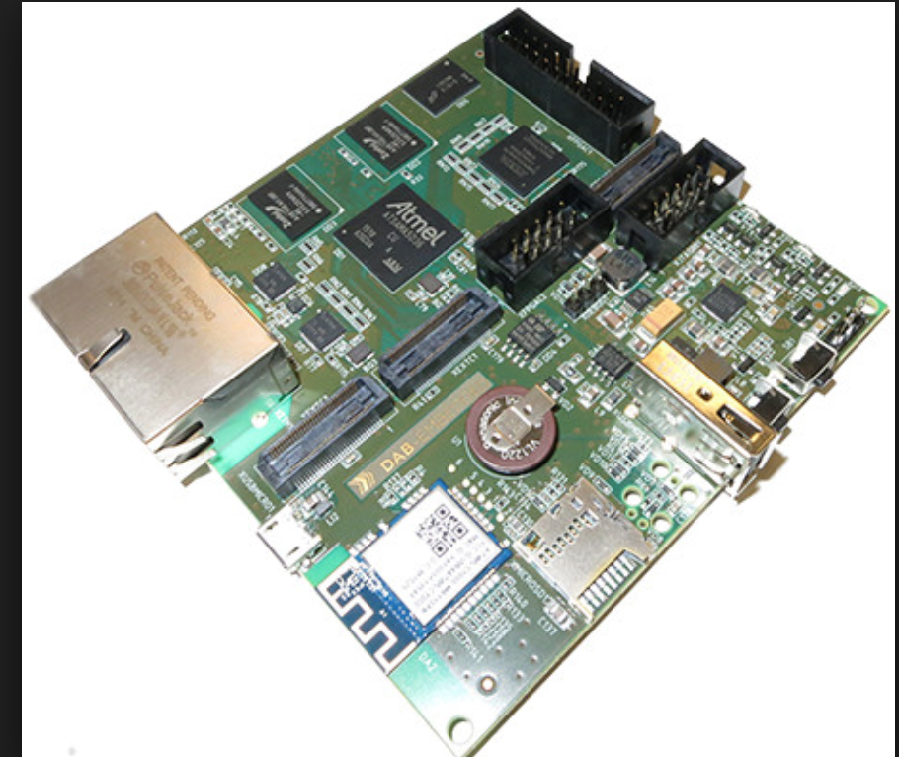
Routers (http://linuxgizmos.com/openwrt-router-sbc-mixes-cortex-a5-and-fpga/)

Slide 23
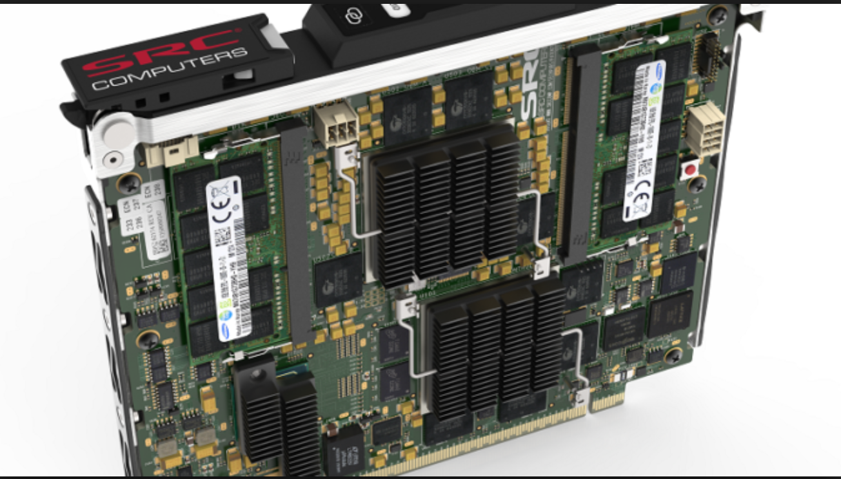
Servers

Slide 24
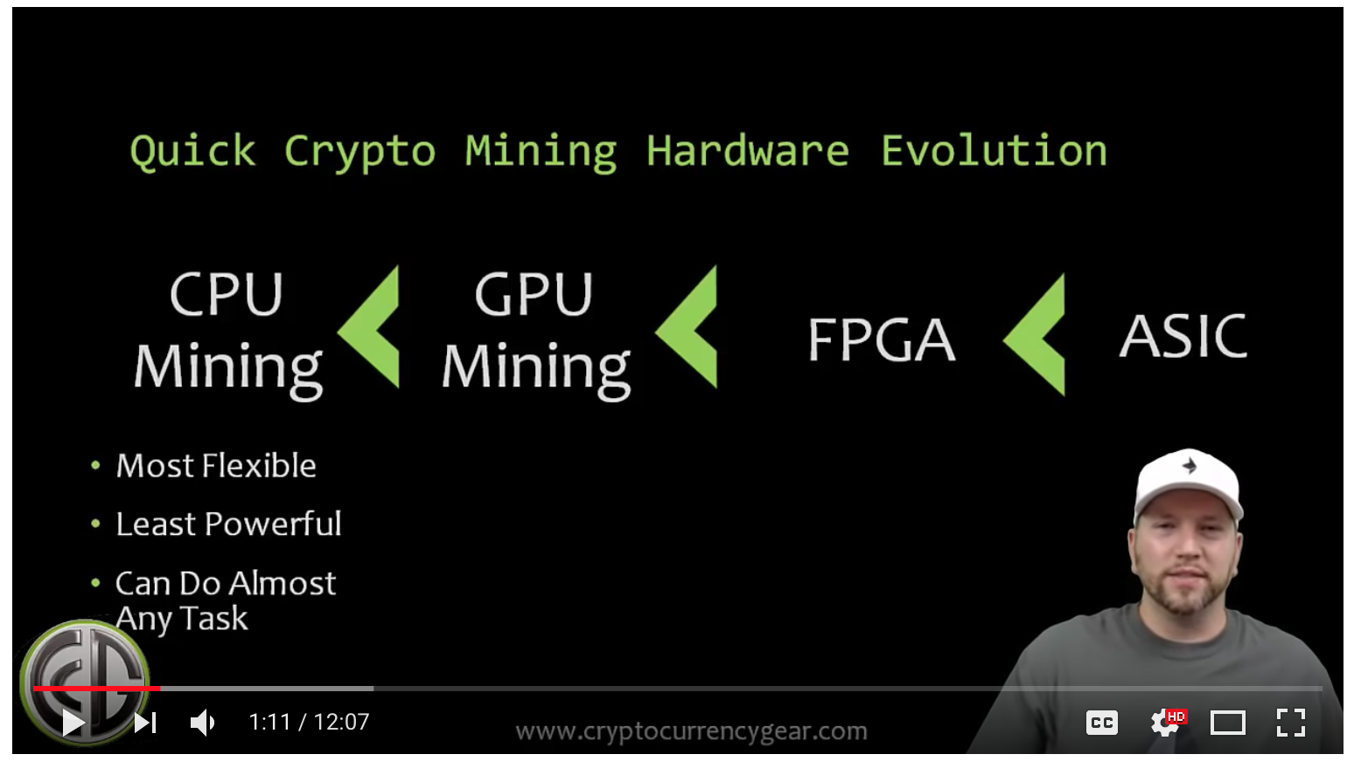
Of Course

Slide 25
General Threat Model
Attacks against the hardware itself
Attacks misusing the HDL implementation
Attacks from outside the electronics environment
Attacks against the Synthesis Pipeline

Slide 26
Hardware is Hard – the intermediate level is even harder
FPGA’s encourage hardware engineers to recapitulate the sins of the last 40 years of computing
FPGA’s are often placed in situations where the data fed to them is intended to be trusted
Security Controls aren’t always the first thought when the device in intended for performance

Slide 27
Hardware Definition Language
Allows you to program hardware with code
Verilog, VHDL and other proprietary variants
Wires, busses, clocks can be defined dynamically

Slide 28
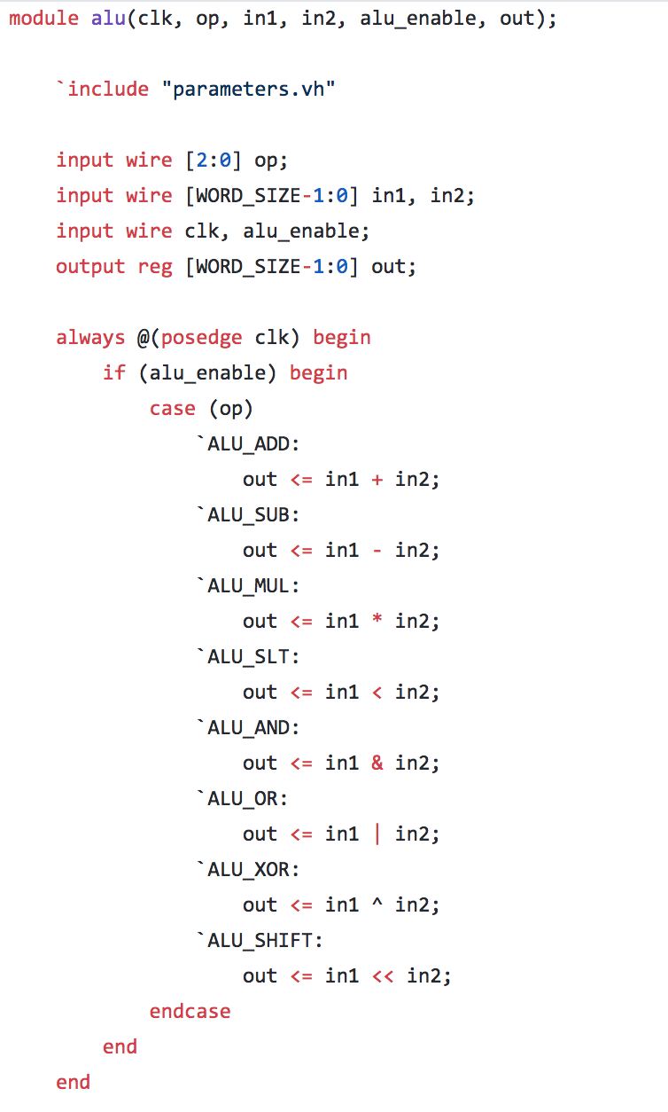
HDL Language – Verilog CPU (https://github.com/ejrh/cpu/blob/master/testbench/alu_tb.v)

Slide 29
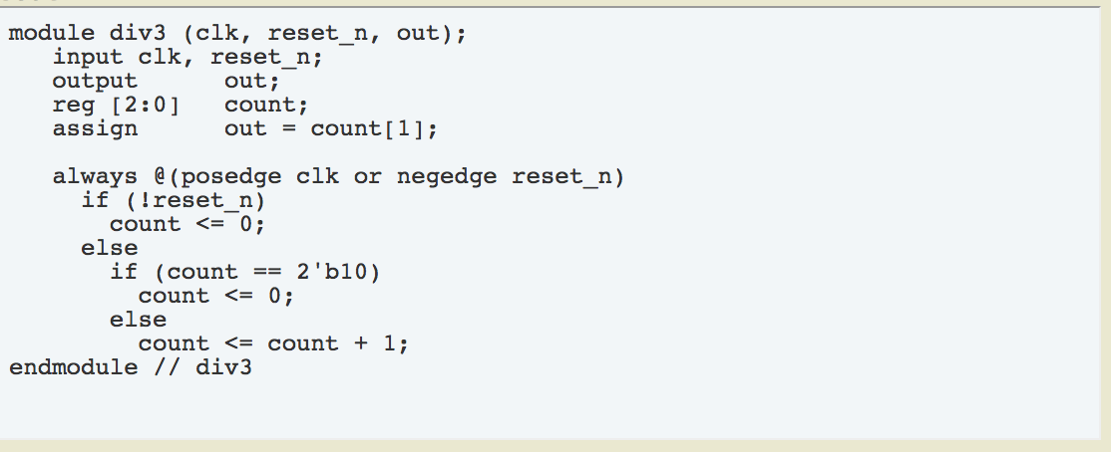
Counting Clock Cycles (https://www.edaboard.com/showthread.php?45866-How-to-write-code-in-Verilog-for-skipping-two-clock-cycles-at-a-time)

Slide 30
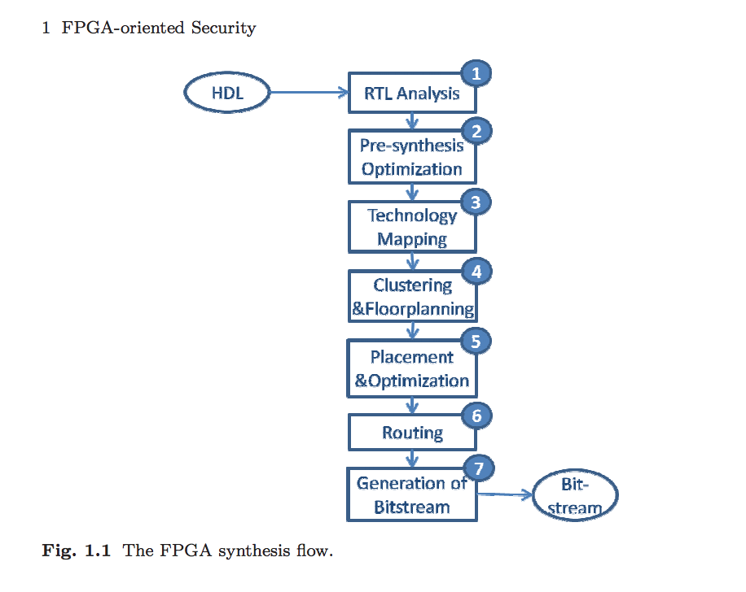
The Synthesis Pipeline(http://web.cs.ucla.edu/~miodrag/papers/Majzoobi_2011.pdf)

Slide 31
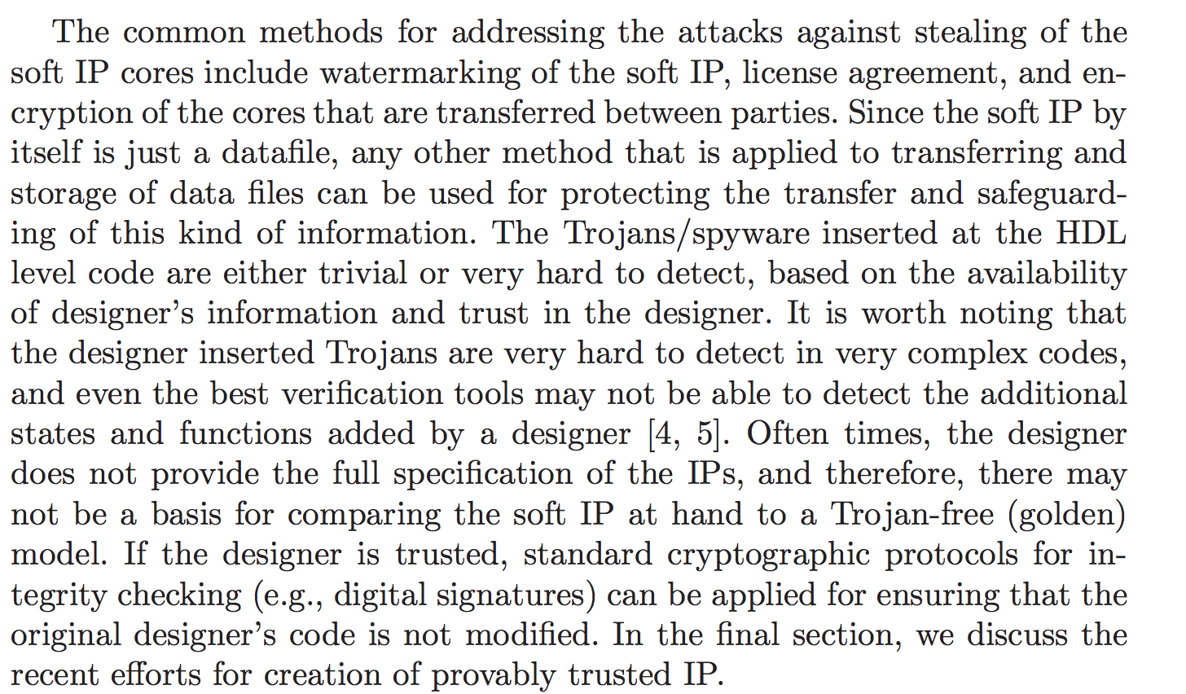
Insider Threats May Be an Issue

Slide 32
Physically Uncloneable Functions
Tie encryption or authentication to device specific factors

Slide 33
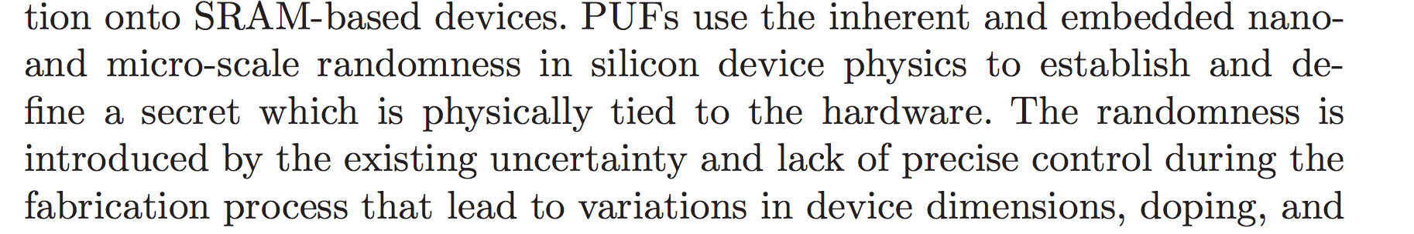
Physically Unclonable Functions

Slide 34
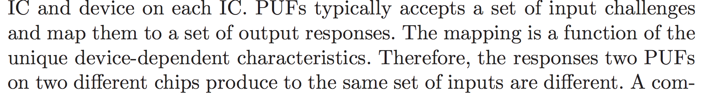
More

Slide 35
How would you implement that?
Measuring propagation delays is the typical method
You can also measure voltages, capacitance and other physical factors
Learning Parity with Noise
There are whole books dedicated to getting this right.
These are not perfect, there are attacks.

Slide 36
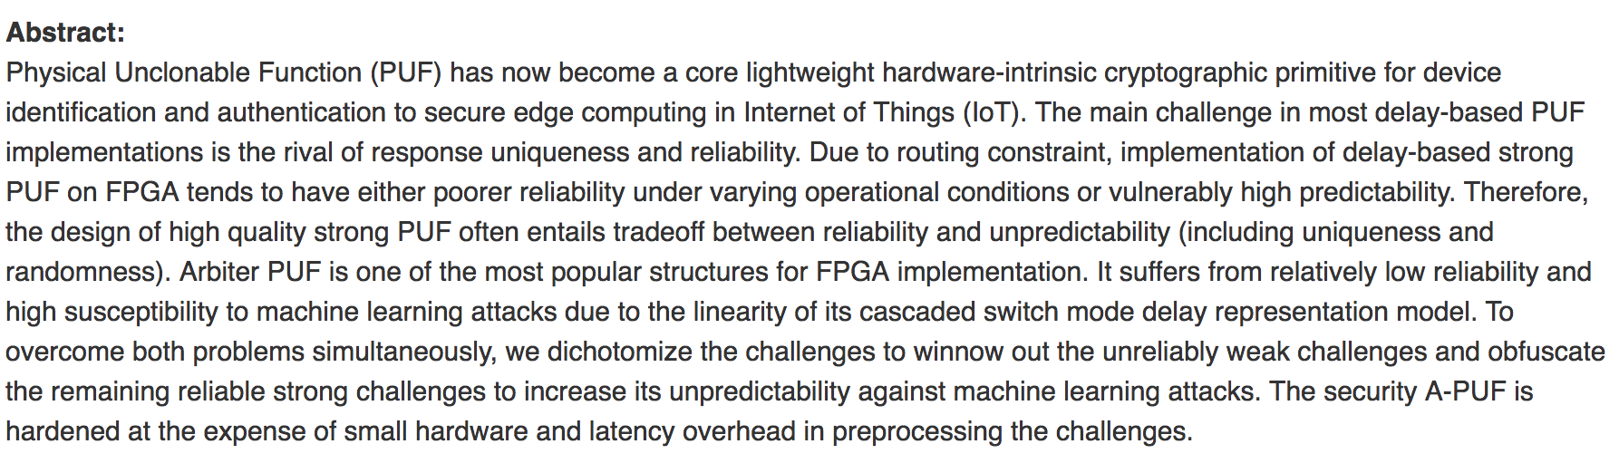
These can be defeated by machine learning

Slide 37
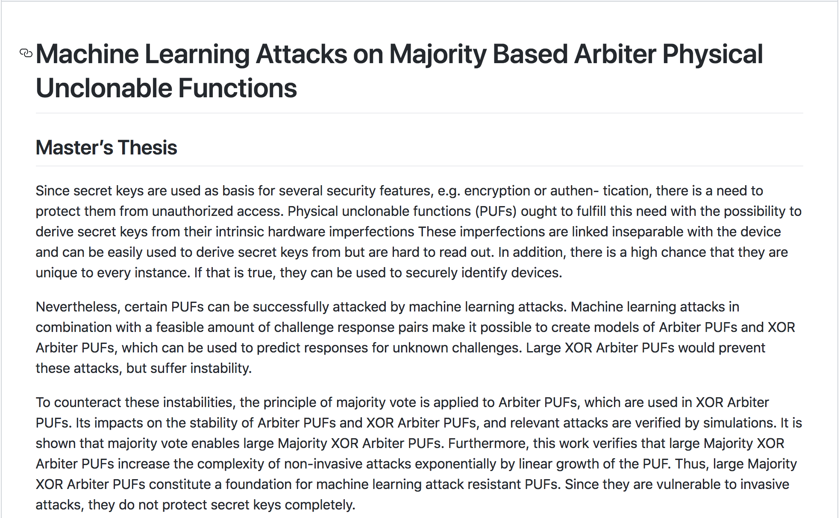
This thesis shows you how (https://github.com/maoswald/cs_masters_thesis)

Slide 38
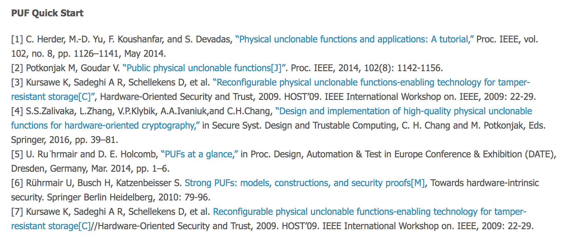
https://zzyue.github.io/PUF/ - Great Further Reading List!

Slide 39

Christoph Boehm is the man when it comes to this topic

Slide 40
Threat 1: Disclosure of IP
Adversaries will attempt to pull your IP off the board
It has to exist in a form the board will understand and needs to be reloaded on each power on in many situations
The time when you power on the device is most vulnerable

Slide 41
Methods for Disclosing FPGA IP
Grabbing IP during configuration off of the device
Grabbing IP during boot
Grabbing IP during configuration
Grabbing IP directly off storage

Slide 42
Bitstream Cloning Attacks
The easiest thing is to abuse the readback functionality of a FPGA where it exists.
Usually a bit can be set to prevent read back, but it’s possible to forget to do this.
Failing this you may have to try and middle the FPGA’s bitstream during boot time. This may be non-trivial.
Encrypted Bitsreams
Integrated Devices

Slide 43
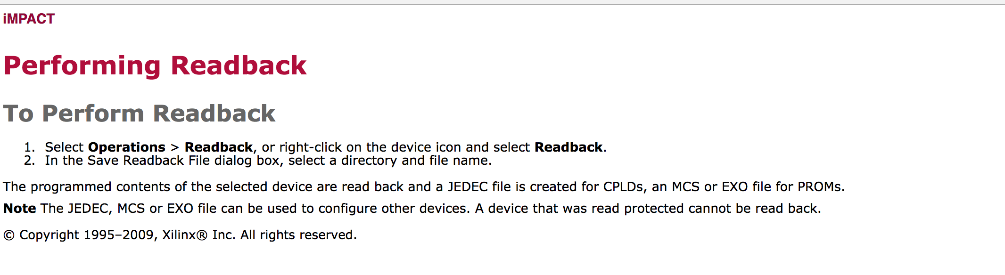
The Easy Way

Slide 44
Bitstream Formats
Typically vary from manufacturer to manufacturer
May vary device to device
Almost always proprietary

Slide 45
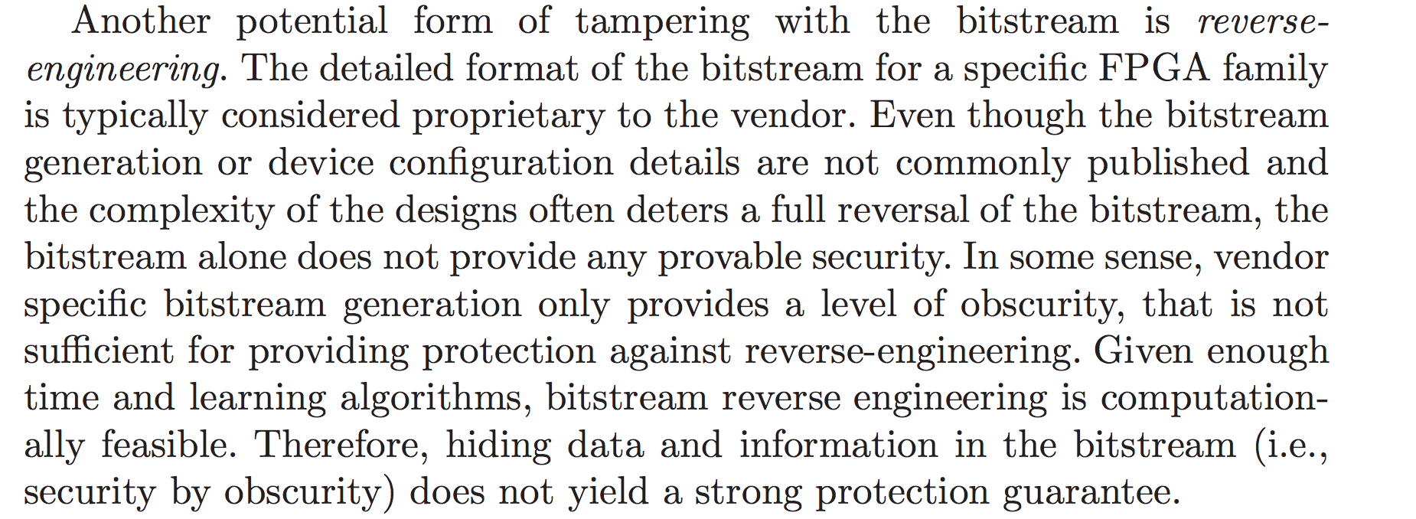
Majzoobi puts it well

Slide 46
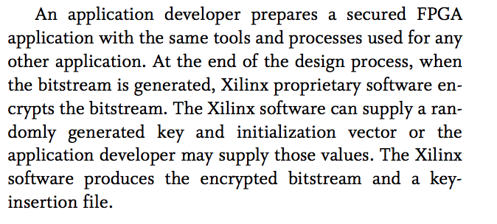
Bitstream Encryption

Slide 47
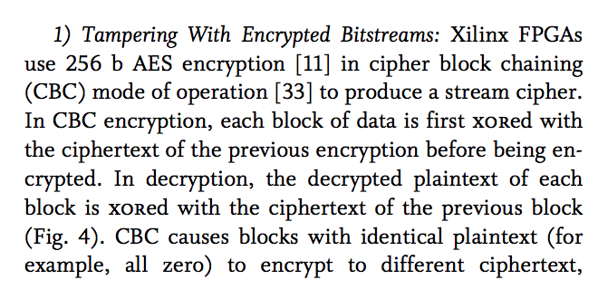
Some FPGA’s use CBC…

Slide 48
Bistream Encryption
Key generated by synthesis software
Encrypted at synthesis time
Key later implanted on the device via jtag

Slide 49
Implementing True Random Numbers In FPGA’s
There are several ways to get true random numbers out of FPGAs
As a security person it may be your job to prove they are in fact random

Slide 50
FPGA Entropy Sources
These actually end up being similar to the places you get randomness for PUFs
Metastability
Propagation Delay
Oscillator Jitter
Oscillator frequency
Phase Locked Loops
Dedicated hardware peripherals

Slide 51
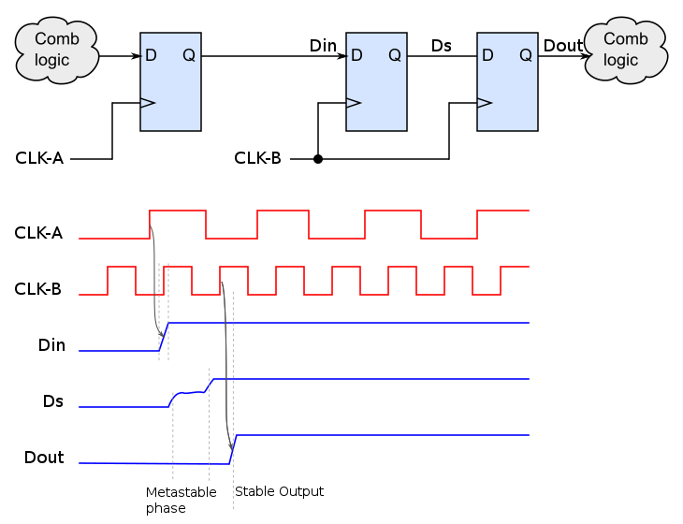
Metastability?

Slide 52
Anti-Tamper Gotchas
Fuses!
Tamper resistant Flash memory cells
Designs which make specific attacks difficult by placement of logic

Slide 53
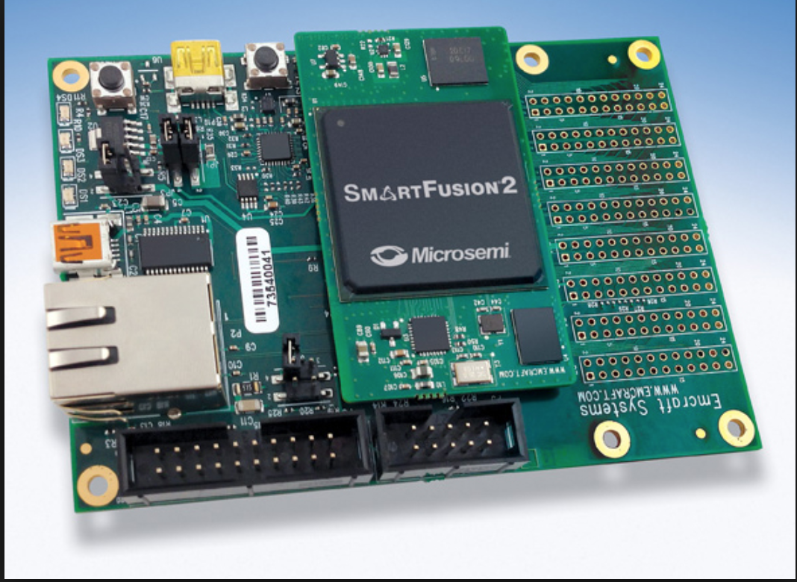
Microsemi Smart Fusion – Distributed Storage

Slide 54
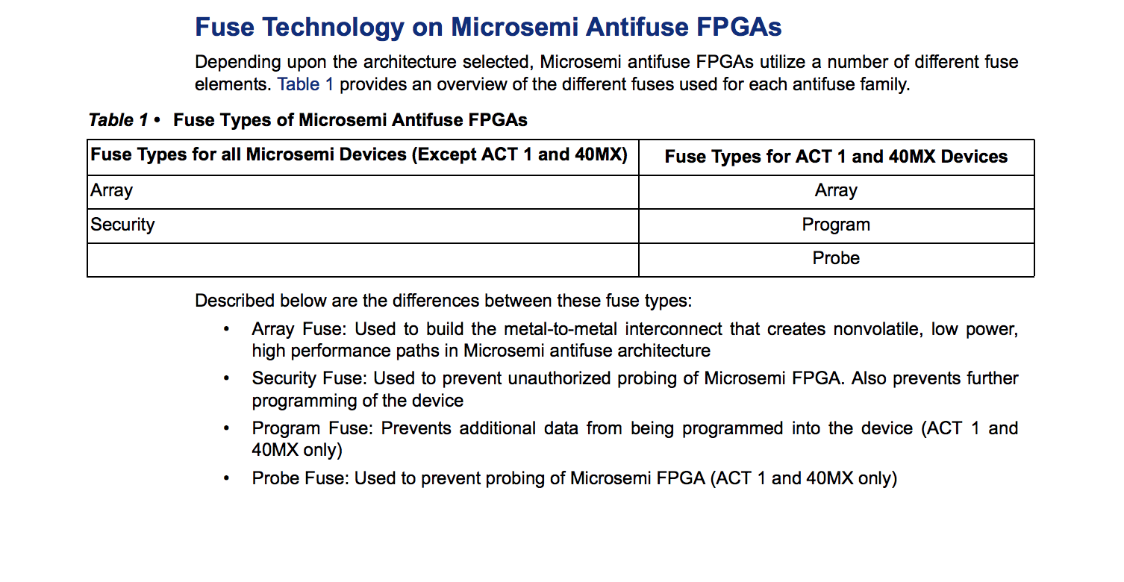
Microsemi FUSELock (https://www.microsemi.com/document-portal/doc_view/129847-ac168-implementation-of-security-in-actel-antifuse-fpgas-app-note)

Slide 55
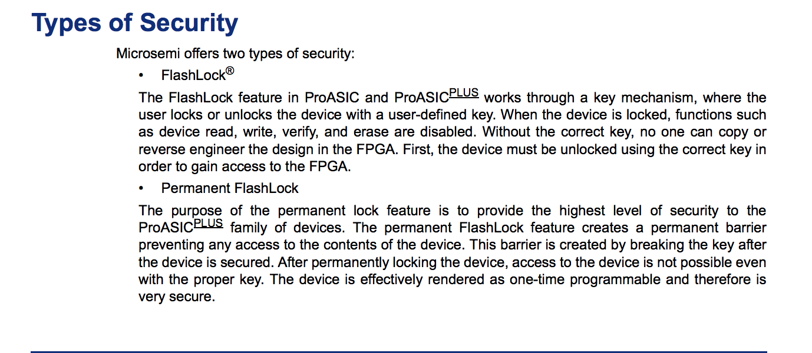
Microsemi Flashlock (https://www.microsemi.com/document-portal/doc_view/129931-ac185-implementation-of-security-in-microsemi-proasic-and-proasicplus-flash-based-fpgas-application-note)

Slide 56
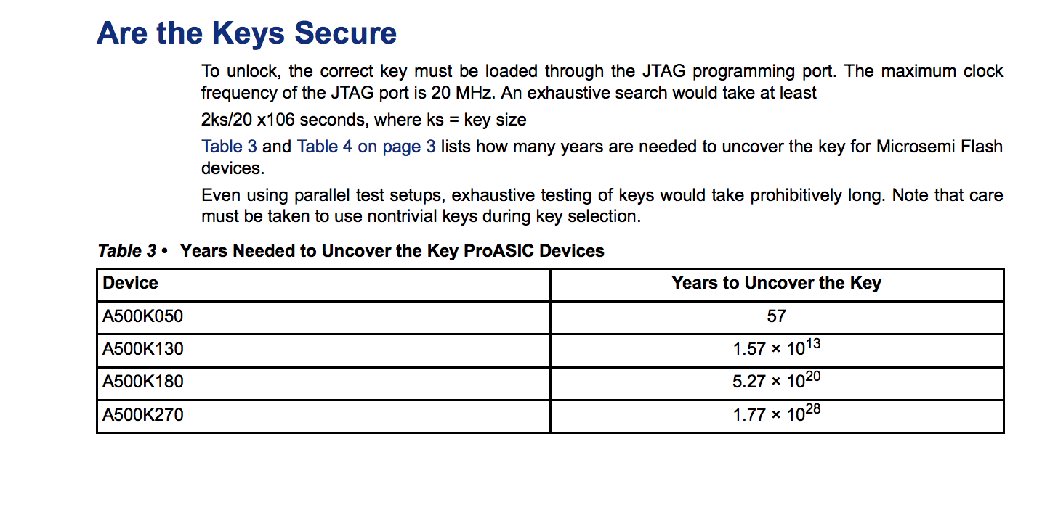
Are the keys secure?

Slide 57
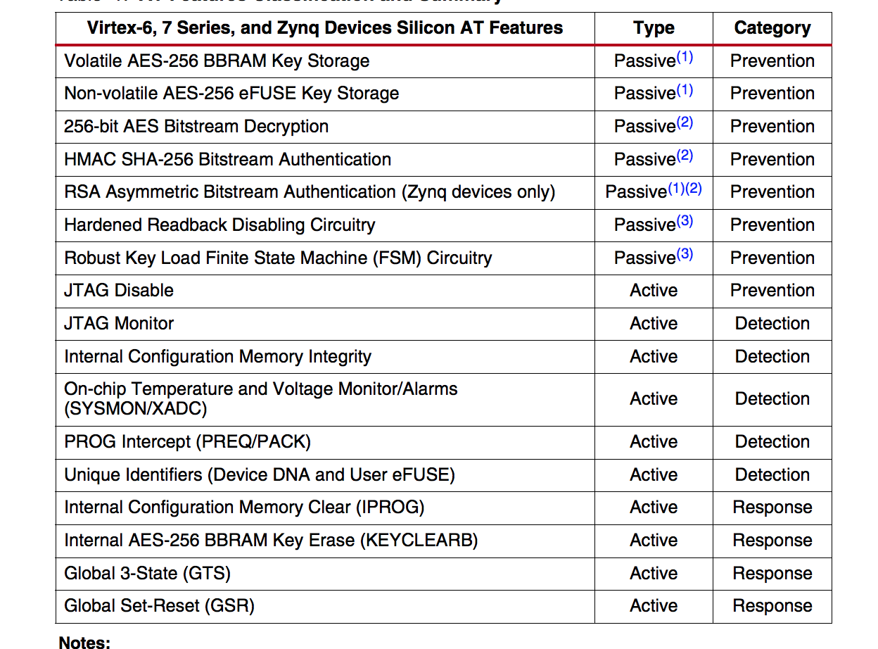
Xilinx Features

Slide 58
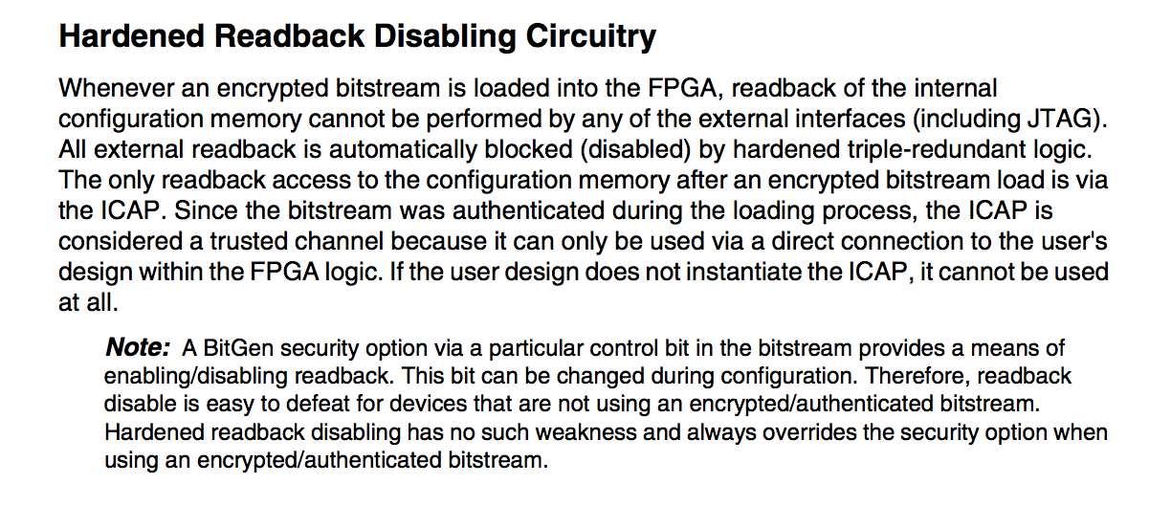
Xilinx - Antireadback

Slide 59
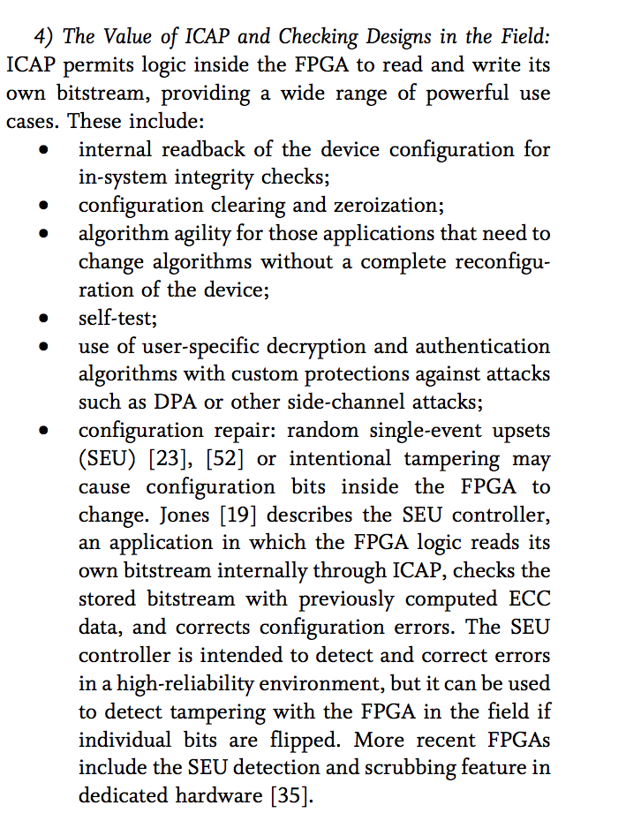
ICAP (https://ieeexplore.ieee.org/stamp/stamp.jsp?arnumber=6849432)

Slide 60
ICAP
Internal configuration port
Makes it possible to rewrite the configuration of the FPGA in the field
Often configured such that the FPGA can rewrite it’s own memory(!)

Slide 61
Threat 2: Damage to Critical Systems
If a FPGA is connected to a critical system abuse of system logic may be used to cause physical damage to that system
Inappropriate Voltage may be induced to produce a short or an overheating situation

Slide 62
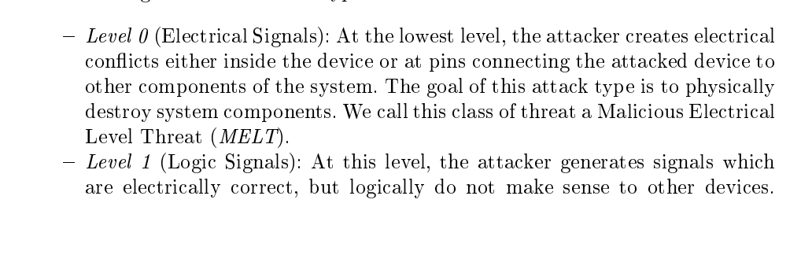
Existing Research on this topic: http://www.cis.upenn.edu/~jms/papers/fpgavirus.pdf

Slide 63
They called it MELT!

Slide 64
What should you look for in your own systems
In much the original research MELT vulnerabilities are created by modifying the bitstream pre-configuration.
This is because in the majority of cases the compiler wont allow the conflicts that are necessary for MELT to occur on the device itself
However, that doesn’t protect peripherals connected to the FPGA. Make sure output voltages are constrained in your designs.

Slide 65
Threat 3: Attacks Against Hardware of the FPGA itself
You might try to reverse engineer it physically
Focused Ion Beam Measurement ($$$)
Scanning Electron Microscope
Analysis with X-Rays
Thermal analysis

Slide 66
Threat 3A: Attacks against the FPGA which place it in an unexpected environment
Out of range temperature
Clock Tampering
Voltage tampering
Ionizing Radiation
FIPS140-2, level 4

Slide 67
Solutions
“Robust Circuitry”
Voltage Regulation
Secure cryptographic implementations
Redundant storage
Use a DAC to implement Shutoffs when temperature is wrong
Physical Isolation of FPGA regions

Slide 68
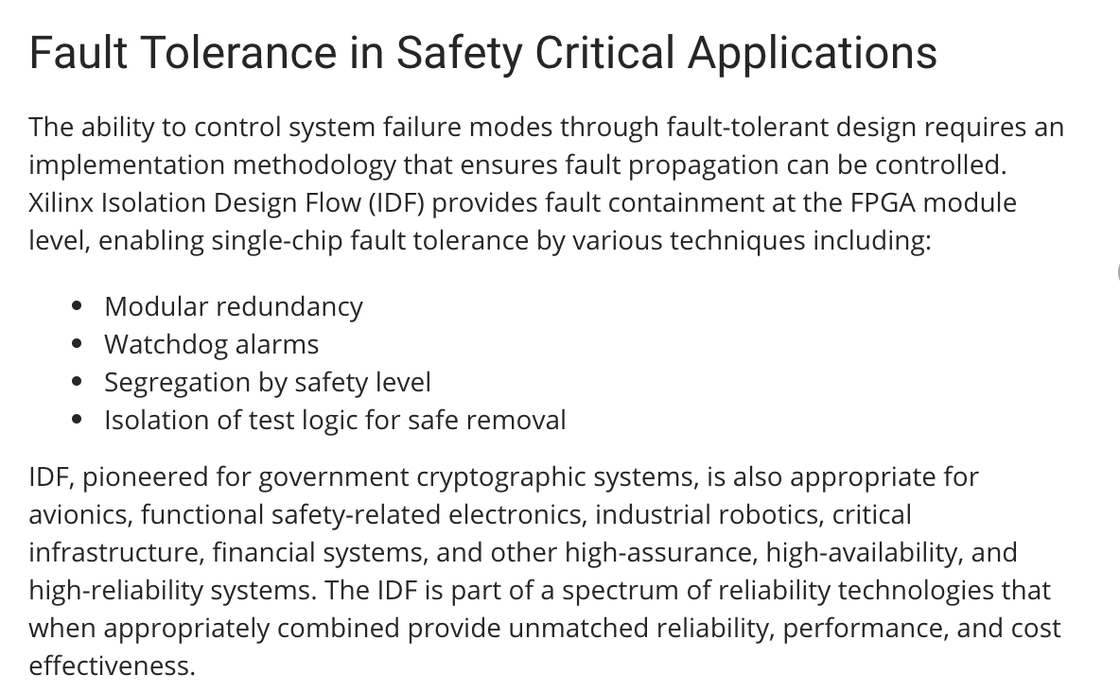
Xilinx – Isolation Design Flow

Slide 69
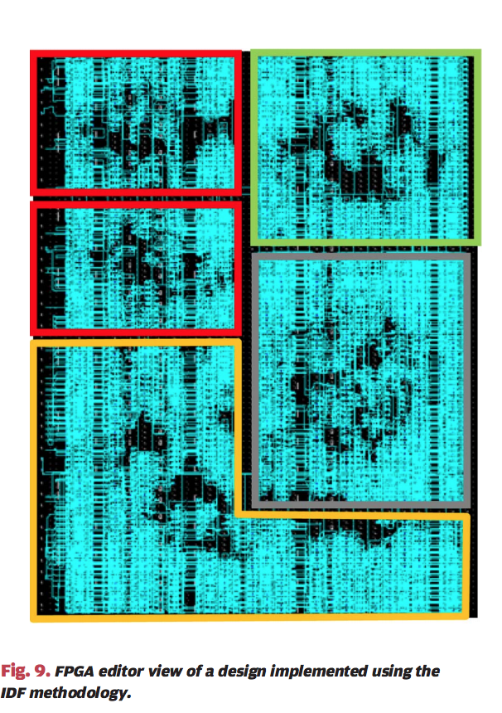
IDF Visualized (Trimberger/Moore https://ieeexplore.ieee.org/stamp/stamp.jsp?arnumber=6849432)

Slide 70
“Single Events Upset”
Radiation causes a bit to flip more or less
Happens a lot more in outer space.

Slide 71
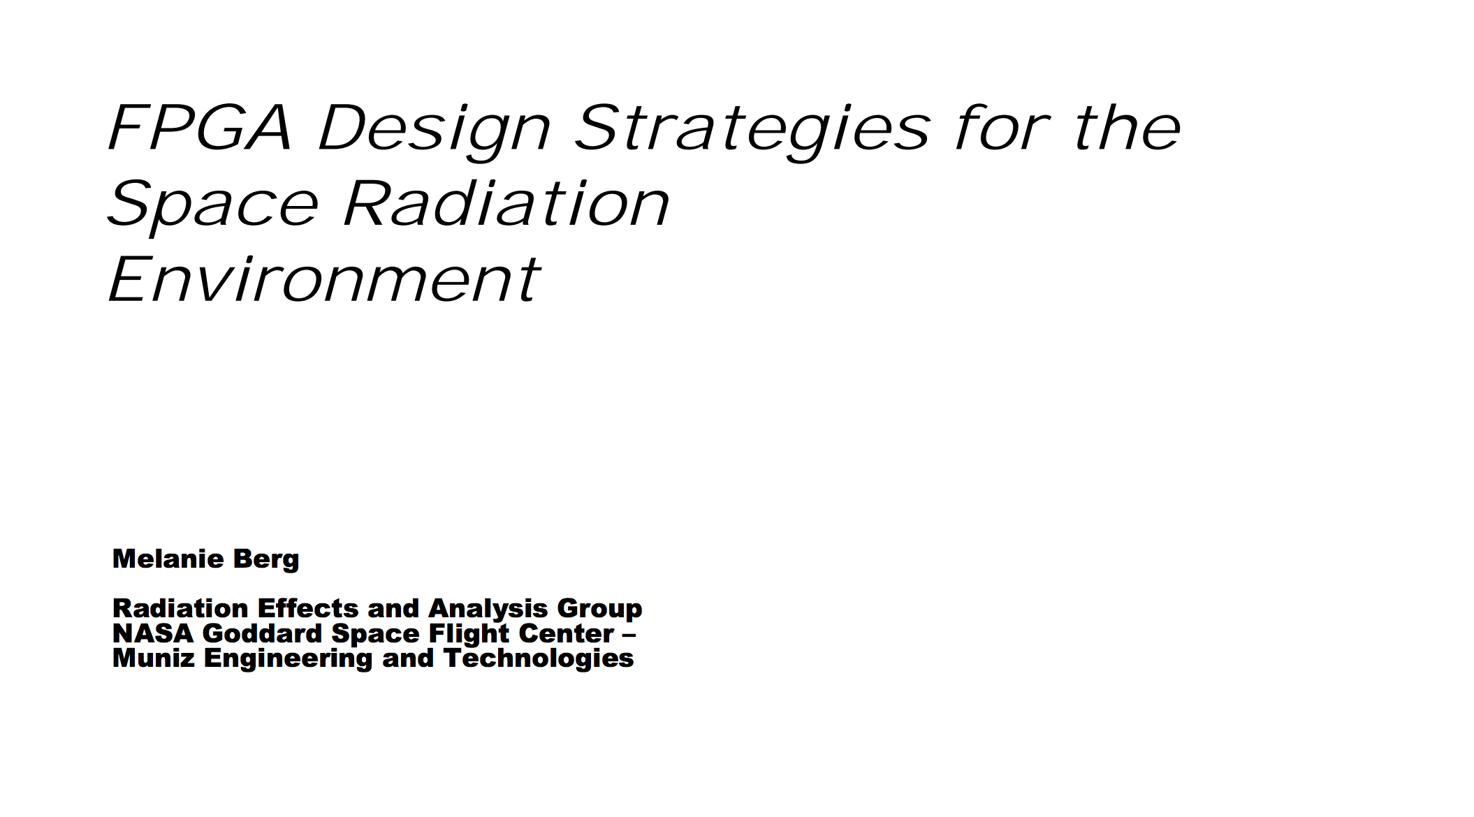
No Really. Space.

Slide 72
High Level Ideas for Radiation Proofing Your FPGA (https://radhome.gsfc.nasa.gov/radhome/papers/seesym06_berg.pdf)
Good Silicon
“Ultra Low Alpha” materials
“Soft Error Mitigation”
Error Correcting Codes
Design around it
Shield
SRAM

Slide 73
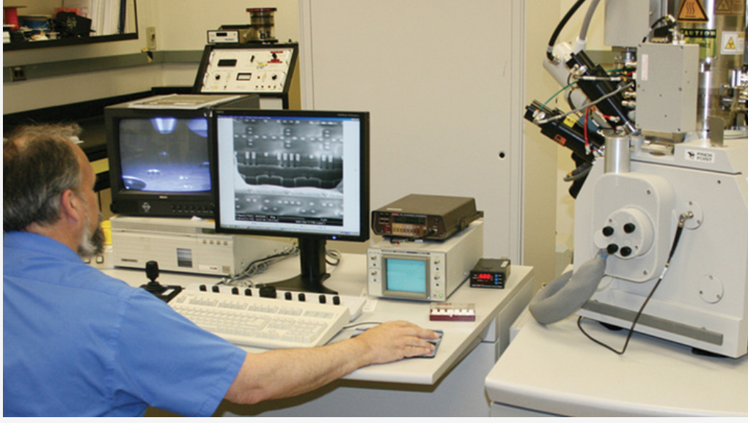
A Guy At BAE Systems Doing Radiation Hardening Testing

Slide 74
Threat 4: Shared IP based issues
FPGA’s have libraries too.
Sort of.

Slide 75
What are IP Blocks?
HDL for your designs provided by 3rd parties.
Often sold by the device manufacturer
Can be as simple as a register and as complex as an entire CPU

Slide 76
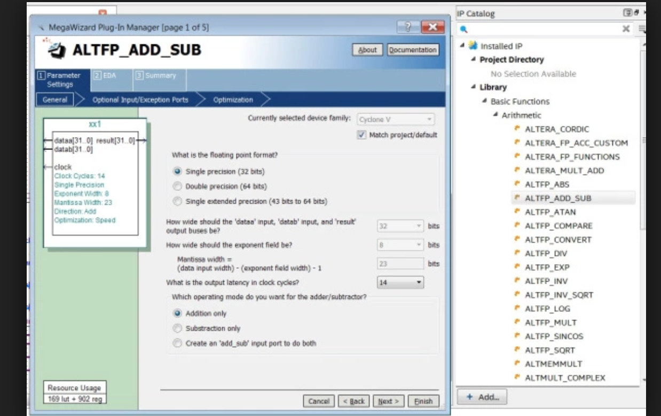
The Intel/Altera IP Blocks Menu

Slide 77
Threat 5: Cryptographic Attacks
Timing based attacks
Side channel / power analysis
EMF analysis
Fault Injection / Glitch Analysis

Slide 78
DPA Attacks
Practical for recovering keys and decrypting encrypted bitstreams
May be thwarted by running the circuit in parallel with other power consumers
Still Effective, active area of research

Slide 79
Timing Analysis
Timing side channels can be used just like a traditional CPU
Constant time algorithms work for this just like on a traditional CPU

Slide 80
Fault Injection
Voltage starvation
Over Voltage
EMF field
Radiation
Can be counteracted if all states can be accounted for
Or Tamper detection
Not too different from traditional CPUs in all this

Slide 81
Epilogue: Security Tools For FPGAs

Slide 82
Static Analysis is Great on FPGA’s!
FPGA’s had cool satisfiability solver technology long before the software industry tried it.
Hardware design was a proving ground for theorem proving based software assurance.
Sadly, most of it is strictly concerned with electrical engineering properties and doesn’t automatically extend to more logical properties of the devices.

Slide 83
Static Timing Analysis
All toolsets provide a suite to do this prior to configuring the design.
Proves soundness in terms of clock and expected propagation of signals through the design.
Without STA the design might include elements that cause it behave non-deterministicly. Deterministic operations may return differing values.
Each component in the design induces a delay that must be accounted for.

Slide 84
Issues Finding Security Bugs at the Intermediate Level
STA doesn’t tell you about logical issues in your design.
Questions like “can the user write to arbitrary memory?” are not answered by static timing analysis.
Without your help it cannot harden your crypto against DPA attacks.

Slide 85
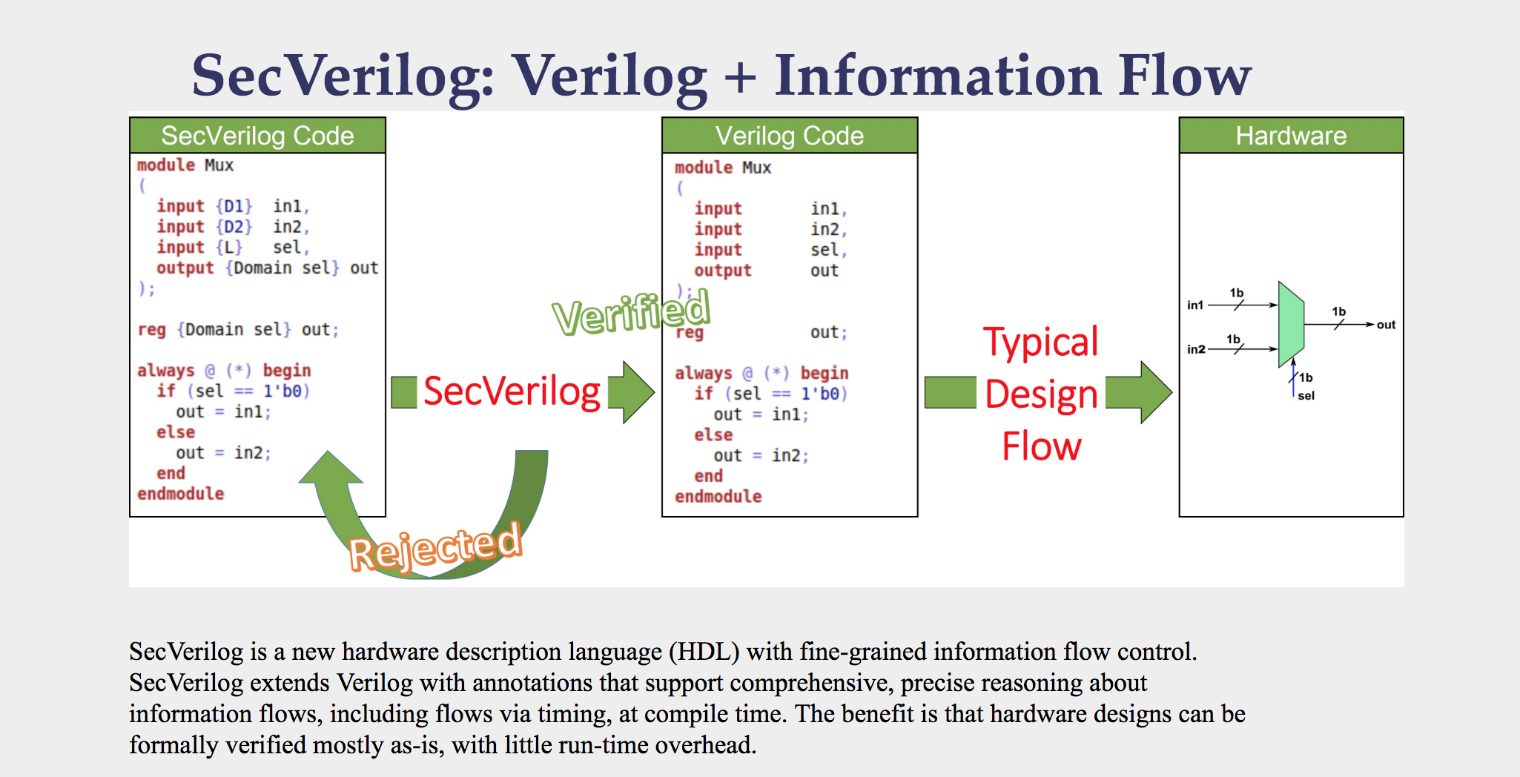
This tool from Cornell is awesome

Slide 86
Issues a Human Would Find
Bad state transitions
Data flow to unintended areas
“Timing Sensitive Information Flow”
Do critical functions check on the state of the clock?
Race conditions
Synchronous vs asynchronous
(logical) Security modes
Security bit
Aliasing
Memory map issues

Slide 87
That’s It!
Hope you liked it
I’m @JohnDunlap2 on twitter

Slide 88
Thanks!

